Slide 1

Project#1 Evaluating how Cache design choices affect the performance of X86 architecture based Microprocessor using Gem5 simulator
Under: Prof DR. Kanad Basu
Team: (100/100) Abhinay Dwadasi (AXD220054)
Yagna Srinivasa Harsha Annadata (yxa210024)
(CE6304) Class of 2023-24 (Spring Semester)

Slide 2
Project Description:
Fine tuning the cache hierarchy of X86 architecture using GEM5 simulator.
The following Design parameters have been manipulated to evaluate the performance of the CPU as specified:
CPU type: Timing
Cache levels: Two levels; L1 and L2 caches.
Cache sizes considered:
128 kB and 256 kB for L1 data cache.
64 kB and 256 kB for L1 Instruction cache.
512 and 1024 kB for L2 cache.
Associativity:
For L1D and L2I: direct mapped and 4-way Set associativity
For L2: Direct mapped and 8-way set associativity.
Cache Block Size: 32 and 64 bytes

Slide 3
GEM5 configuration part-1
Gem5 was accessed from the virtual server CE6304.utdallas.edu
Instead of accessing the Gem5 directly on the server we have copied the files from Gem5 directory (/usr/local/gem5). Copying the configuration files and moving them to our directory was done using “cp rf-” command.
We then built the X86 processor in the copied directory on our server using no machine. The command used was (scons build/X86/gem5.opt)
We then downloaded all the 5 bench mark files from Github using the link: https://github.com/timberjack/Project1_SPEC
We then saved all the files in a folder called bench marks in the same Gem5 directory.

Slide 4
GEM5 configuration part-2
In order to simulate X86 based CPU we, use the following benchmarks specified: 401.bzip2, 429.mcf, 456.hmmer, 458.sjeng and 470.lbm
An Output directory is also created to save all the Stats.txt files which are required to calculate the CPI
We will be using System Call Emulation mode as prescribed using the script in the path: “/configs/example/se.py”.
The Number of instructions chosen is 300000000 for all benchmarks except 429.mcf which has 75000000.
All the input variables are dynamically allocated according to the chosen configuration.

Slide 5
GEM-5 Config3uration part-3
Outputs are stored in the local machine with respective names and configuration in their title.
We have written a python code to generate the output of respective benchmark which is also attached in the software package.
Also, we have written python code to calculate the CPI of the generated output files which saves the data in two text file in sorted and unsorted formats.

Slide 6
Optimum CPI for 401.bzip2
The minimum CPI obtained was : 1.37867333
The memory configuration is as follows:
Block size : 64
L1 Data Cache Associativity: 4
L1 Instruction Cache Associativity: 4
L2 Cache Associativity: 8
L1 Data Cache Size: 256kB
L1 Instruction Cache Size: 256kB
L2 Cache Size: 1mB

Slide 7


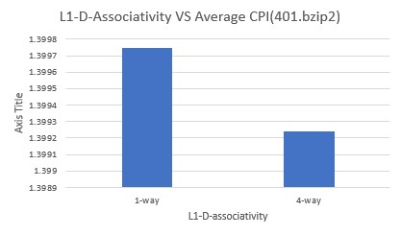
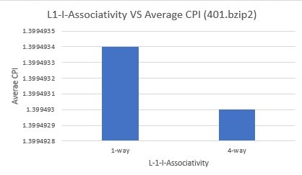
Graphical Analysis of L1 Associativity for 401.bzip2
As seen in graphs, from the derived values using 401.bzip2 benchmark and the average CPI calculated, following conclusions can be made:
The performance of a CPU with direct mapped L1-I and L-1D cache shows considerably lower performance when compared with a 4-way set associative L1-I and L1-d cache.
This mean that, the more the associativity the lower the CPI and the better the performance.

Slide 8
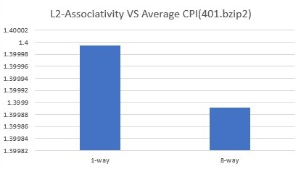
Graphical Analysis of L2 Associativity for 401.bzip2
From the simulation results obtained by running the 401.bzip2 benchmark the following observations about the L2 associativity can be made:
The direct mapped L2 cache displays considerably less performance.
The 8-way set associativity of the L2 cache has better performance and less number of misses.
The more the associativity of L2 cache the better the performance.

Slide 9
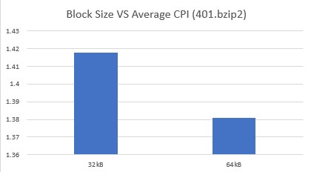
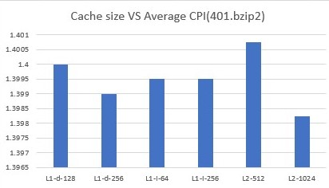
Graphical Analysis on Cache and Block Size for 401.bzip2
With 401.bzip2 benchmark it is observed the block size has considerably more affect on the performance the than the cache size.
Conclusion: Hence when it comes to size of multiple levels of Cache and the block, the performance is directly proportional to the Size.

Slide 10
Optimum CPI for 429.mcf
The minimum CPI obtained was : 1.3821154086666667
There are two configurations which had the similar CPI the only difference was the L1 Instruction cache size.
The memory configuration is as follows:
Block size : 64
L1 Data Cache Associativity: 4
L1 Instruction Cache Associativity: 4
L2 Cache Associativity: 8
L1 Data Cache Size: 256kB
L1 Instruction Cache Size: 256kB,64kB
L2 Cache Size: 1mB

Slide 11
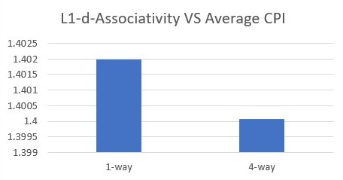
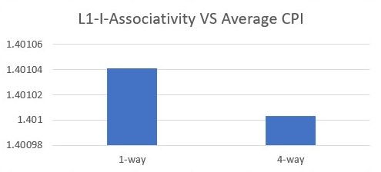
Graphical Analysis of L1 Associativity for 429.mcf
As seen in graphs, from the derived values using 401.bzip2 benchmark and the average CPI calculated, following conclusions can be made regarding the associativity:
For both L1I and L1D caches the performance of the processor is directly affected by the associativity.
Conclusion: As the associativity increases the performance of the processor also increase which means the CPI Decreases as we increase the associativity of caches at multiple levels..

Slide 12
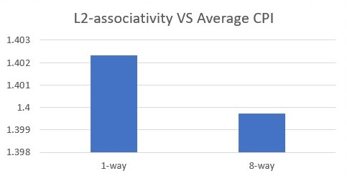
Graphical Analysis of L2 Associativity for 429.mcf
The simulation values obtained by running the 429.mcf benchmark the following observations about the L2 associativity can be made:
The direct mapped L2 cache displays considerably less performance.
The 8-way set associativity of the L2 cache has better performance and less number of misses.
Conclusion: The more the associativity of L2 cache the better the performance.

Slide 13
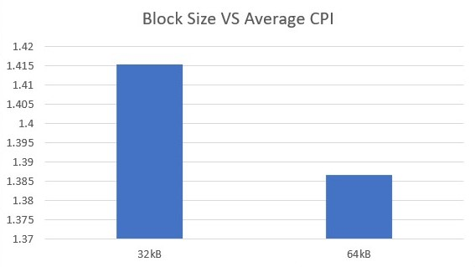
Graphical Analysis for 429.mcf for Cache and Block Size
Using 429.mcf benchmark it is observed the block size has considerably more affect on the performance the than the cache size.
Conclusion: When it comes to size of multiple levels of Cache and the block, the performance is directly proportional to the Size.

Slide 14
Optimum CPI for 456.hmmer
The minimum CPI obtained was : 1.0180928533333333
The memory configuration is as follows:
Block size : 64
L1 Data Cache Associativity: 4
L1 Instruction Cache Associativity: 4
L2 Cache Associativity: 8
L1 Data Cache Size: 256kB
L1 Instruction Cache Size: 256kB
L2 Cache Size:1mB
There are three configurations which had the similar CPI the other 2 are, L2 cache size at 512kB and rest of the configurations being the same.
L2 cache associativity at 1 with having all the other configurations same.

Slide 15
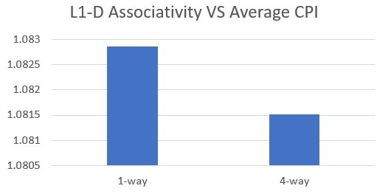
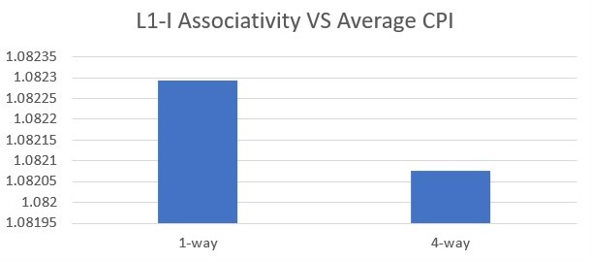
Graphical Analysis of L1 Associativity for 456.hmmer
By running 456.hmmer benchmark and the average CPI calculated, following conclusions can be made regarding the associativity:
Both L1I and L1D caches the performance of the processor is directly affected by the associativity.
Conclusion: As the associativity increases the performance of the processor also increase which means the CPI decreases

Slide 16
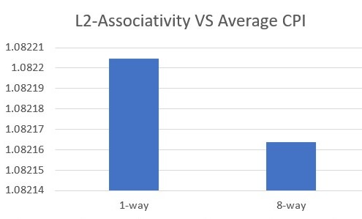
Graphical Analysis of L2 Associativity for 456.hmmer
By running the 456.hmmer benchmark the following observations about the L2 associativity were made:
It can be observed that direct mapped L2 cache reflects considerably less performance.
8-way set associativity of the L2 cache results in better performance and decreased number of misses.
Conclusion: Associativity of L2 cache is proportional to the performance.

Slide 17

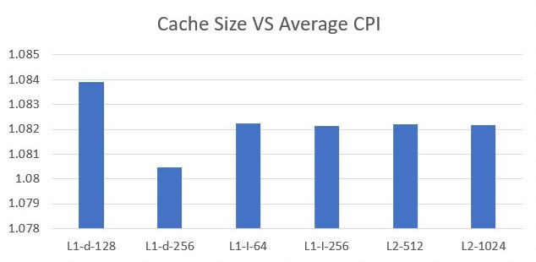
Graphical Analysis of cache size and block size for 456.hmmer
456.hmmer benchmark when run in system emulation mode, it is deduced that the block size has considerably more affect on the performance the than the cache size. We can see that CPI decreases by 8% when block size is doubled
Conclusion: When it comes to size of multiple levels of Cache and the block, the performance is directly proportional to the Size of the Cache as well as the logical blocks.

Slide 18
Optimum CPI for 458.sjeng
The minimum CPI obtained was : 1.48886607
The memory configuration is as follows:
Block size : 64
L1 Data Cache Associativity: 4
L1 Instruction Cache Associativity: 4
L2 Cache Associativity: 8
L1 Data Cache Size: 256kB
L1 Instruction Cache Size: 256kB
L2 Cache Size:1mB

Slide 19
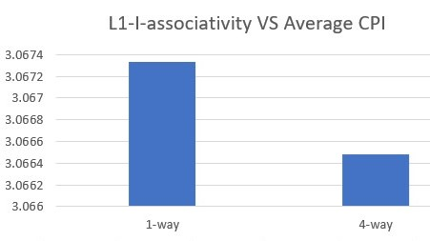
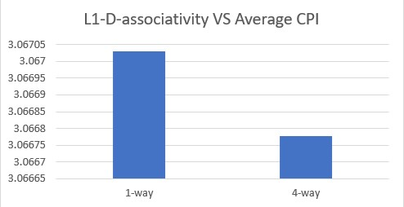
Graphical Analysis of L1 Associativity for 458.sjeng
By running 458.sjeng benchmark and the average CPI calculated, following conclusions can be made regarding the associativity:
Both L1I and L1D caches the performance of the processor is directly affected by the associativity.
Conclusion: As the associativity increases the CPI of the processor also decreases.

Slide 20
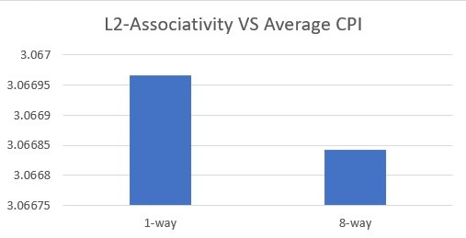
Graphical Analysis of L2 Associativity for 458.sjeng
By running the 458.sjeng benchmark the following observations about the L2 associativity were made:
L2 cache when directly mapped has the lowest performance.
L2 cache 8-way has the better performance then any other Associativity.
Conclusion: Associativity of L2 cache is proportional to the performance.

Slide 21
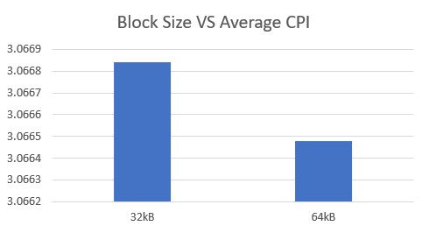
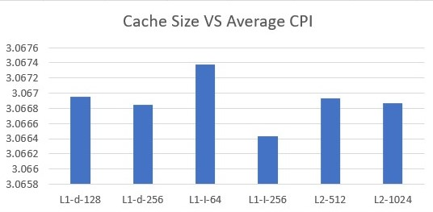
Graphical Analysis of Cache and block size for 458.sjeng
458.sjeng benchmark when run in system emulation mode, it is deduced that the block size has considerably more affect on the performance the than the cache size. We can see that CPI decreases when block size is doubled
Conclusion: When it comes to size of multiple levels of Cache and the block, the performance is directly proportional to the Size of the Cache as well as the logical blocks.

Slide 22
Optimum CPI for 470.lbm
The minimum CPI obtained was : 1.0004313533333333:
The memory configuration is as follows:
Block size : 64
L1 Data Cache Associativity: 4
L1 Instruction Cache Associativity: 4
L2 Cache Associativity: 8
L1 Data Cache Size: 256kB
L1 Instruction Cache Size: 256kB
L2 Cache Size:1mB

Slide 23
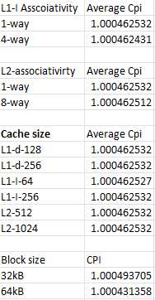
Anomalies with 470.lbm
The Graphical analysis of 470.lbm is not available because we found anomalies in the results obtained as shown in the figure.

Slide 24
Optimum CPI
The minimum CPI is found for all the benchmarks, 401.bzip2, 429.mcf 456.hmmer, 458.sjeng, and 470.lbm, with the configuration which we considered is given below.
Block size : 64
L1 Data Cache Associativity: 4
L1 Instruction Cache Associativity: 4
L2 Cache Associativity: 8
L1 Data Cache Size: 256kB
L1 Instruction Cache Size: 256kB
L2 Cache Size: 1mB
There are other configurations which have the same CPI value in respective benchmarks, but they were not considered as they are not consistent as the above configuration which had the minimum CPI in all the benchmarks

Slide 25
Optimum CPI with conditions
There were 2 given conditions, not having more than 256kB size for L1 and 1mB for L2. so, we considered L1 Data cache: 128kB and L1 Instruction cache: 64kB and L2 cache: 1mB
With the prescribed conditions, we found the minimum CPI when simulated with the following configuration
Block size : 64
L1 Data Cache Associativity: 4
L1 Instruction Cache Associativity: 4
L2 Cache Associativity: 8
L1 Data Cache Size: 128kB
L1 Instruction Cache Size: 64kB
L2 Cache Size: 1mB

Slide 26
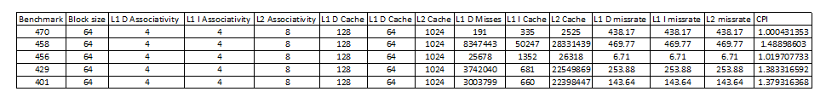
Accumulated Configurations for the optimum CPI with separated L1(256kB) and Unified L2(1mB)

Slide 27
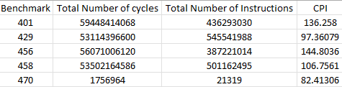
CPI values calculated with No cache specified while building the cpu
We have calculated the CPI by dividing the number of cycles and the number of instructions to find the below values, however the values were found to be anomalous and hence no analysis was presented.

Slide 28
Better Cache?
If we need better performance, we consider larger sizes of the memory and higher Associativity in our memory hierarchy.
But we should also consider that cost increases as the cache size increases.
Benefits of larger cache is better hit rate and more storage for processing.
Higher Associativity reduces the cache misses and conflict, but also increases the cache cost because of the hardware overhead.

Slide 29
Cost Function
Cost function is directly proportional to the size of the cache, hence larger the cache more is the cost. L1 cache is costlier per unit than L2 cache.
So, we defined the cost function in the following way
Cost function = (L1 Data cache size x L1 cache cost per unit)+(L1 Instruction cache size x L1 cache cost per unit)+(L2 cache size x L2 cache cost per unit)+(L1 Data cache Associativity x L1 Data cache Associativity cost)+(L1 Instruction cache Associativity x L1 Data cache Associativity cost)+(L2 cache Associativity x L2 cache Associativity cost)

Slide 30
Optimizing the cost
According to an article by University of Texas at Austin, we found that the costs are as below in 2010:
Cost of L1 cache = 0.003$/kB
Cost of L2 cache = 0.00002$/kB
Cost of L1 Associativity = 0.25$/kB
Cost of L1 Associativity = 0.007$/kB
For our optimum configuration mentioned in the page number:11, the cost is: 3.6125$
We also found that the cost is in the range of 1-4$

Slide 31
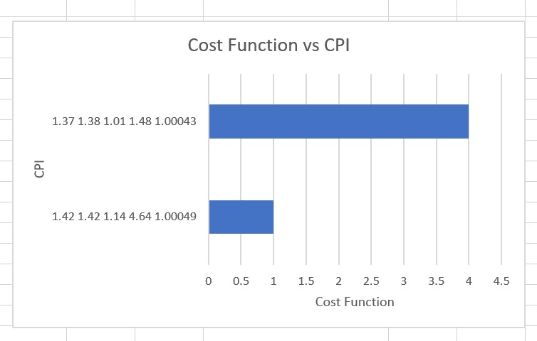
Graphical Representation of Cost vs Cpi
Configuration:
Block size : 64
L1 Data Cache Associativity: 4
L1 Instruction Cache Associativity: 4
L2 Cache Associativity: 8
L1 Data Cache Size: 256kB
L1 Instruction Cache Size: 256kB
L2 Cache Size: 1mB
Cost = (256x 0.003)+(256 0.003)+(1024 x 0.00002)+(4 x 0.25)+(4x 0.25)+(8 x 0.007)
Cost = 3.6125$/configuration

Slide 32
Conclusion
When CPI is minimum the performance is better.
CPI is minimum when the cache size is larger.
CPI is inversely proportional to the Associativity.
We observed that as CPI decrease, Cost function increases.
Which means performance comes with the cost.

